Slide 1
Behavioral Health Information Technologies and Standards (BHITS) II
Omnibus Care Plan
Organization Admin User Guide
Developed by FEI Systems for SAMHSA BHITS September 2018

Slide 2
Contents
Introduction
Chapter 2: Manage Locations
Chapter 2: Manage Healthcare Services
Chapter 3: Manage Patients
Chapter 4: Manage Users

Slide 3

Introduction: Omnibus Care Premise
Patient-centered care revolves around effective and efficient care coordination across care providers, patient engagement, social connectedness, and facilitating the patients’ treatment beyond episodic or chronic treatment.
Today, the healthcare environment is fragmented and ineffectual in providing 360⁰ whole-patient care with the mix of private and public insurers and self-pay with a large number of no-pay patients.
SAMHSA is devoted to the care and treatment of behavioral health patients. New models of paying for care are being developed and initiated with the objective to reduce the cost of healthcare.

Slide 4
About the Omnibus Care Plan
A patient-centric, standards-based, goal-driven treatment plan
Application through which the patient and his or her care team can communicate
Authoritative source for care planning
Synthesize, reconcile, and de-conflict patients’ data
Monitor patients’ data and monitor processes across health care institution boundaries
Real-time integrated view of an individual care plan
Includes structured and narrative information

Slide 5
Omnibus Care Plan Modules
Organization Administration Module–Adding and managing organization details, contact personnel, locations and activity definitions
Practitioners Module–Adding and managing practitioner details, practitioner roles and organization association
Patients Module–Adding and managing patient details, patient’s care teams (which include members across organizations, related persons and other patients) and patient’s insurance/benefits details
OCP Access Module–Register users to OCP and manage user access
Appointments and Scheduling Module–Creating appointments, appointment actions (accept, tentative, decline), calendar view, appointments panel and importing organization Outlook calendar into OCP
Tasks and To-Do Module–Creating, managing and updating patient-related tasks (based on organization defined activity definitions) and patient related To-Dos
Communications Module–Logging patient communications and associate communications with appointments, tasks and To-Dos
Care Planning Module–Creating and managing care plan in Quippe Clinical Lens
Screeners and Assessment Module–Patient screeners and assessments through bhworks CUBS assessment tool
Consent Management Module–Creating and managing patient’s consents through Consent2Share
SMART-on-FHIR Apps Management Module–Consent2Share, Quippe Clinical Lens & Designer, bhworks CUBS Assessment

Slide 6


Omnibus Care Plan Functional Overview
Administrative
Program, Services, Locations
Patient Enrollment
Practitioners, Organizations
Episode of Care
Care Coordination
Caseload Mgmt. Dashboard
Program Mgmt.
Screener/ Assessment
Scored screening and assessments (MA Assessment, PHQ9, PHQ4, etc.)
BH-Works Comprehensive Assessment
Care Planning
SOAP/Visit Notes
Outreach/ Activity Management
Smart Notes
Dynamic Care Plan Summary
Scheduling/ Appointment
New Appointments
Encounter Management
Goals and Interventions based on Outcomes/scores
Patient Consent
Computable Scores/sub-scores (LOINC)
Enrollee/ Consumer Dashboard
Standards-based Data Shared Among Applications
5

Slide 7
Omnibus Care Plan Portal Introduction: Focus of the Demonstration
OCP Admin
Onboarding of organizations to OCP and adding practitioners to OCP
Managing roles/users in UAA and Helpdesk/Troubleshooting
Org Admin
Managing organization locations, healthcare services, activity definitions
Associating practitioners to organization/location and assigning roles
Care Manager
Manage patient information, care teams, and assign care coordinators
Patient consents
Care Coordinator
Tasks, To Do, Appointments, Communication, Assessments
Care Coordination activities and care plan management
Patient
Other Possible Functional Roles
Similar Care coordination activities for Benefits specialist, Front Office, Health Assistant, and so on
Patient information, Care Team
Business Function Role
High-level Responsibilities
Appointments, Communication, Consents
Notes:
Modify this slide based on changes in OCP admin slide

Slide 8
About the Omnibus Care Plan User Guides
This Omnibus Care Plan User Guides will provide information about how different users navigate the Omnibus Care Plan, and more:
Omnibus Care Plan Admin User Guide
Organization Admin User Guide
Care Manager User Guide
Care Coordinator User Guide
Other Roles
SMART on FHIR Applications

Slide 9
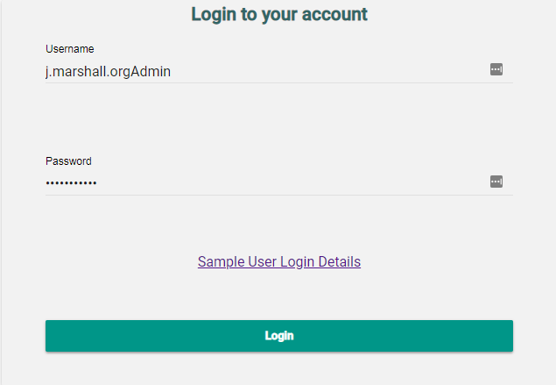
Role of the Organization Admin
Managing organization locations, healthcare services, activity definitions
Associating practitioners and staff to organizations and locations and assigning roles
Adding patient records
Registering organizations to OCP with appropriate credentials and permission groups

Slide 10
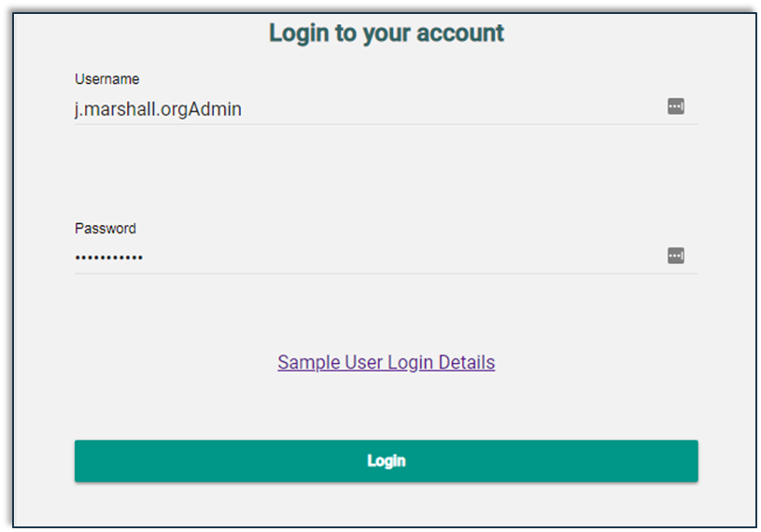
Organization Admin Login Page
Login using Org Admin credentials

Slide 11
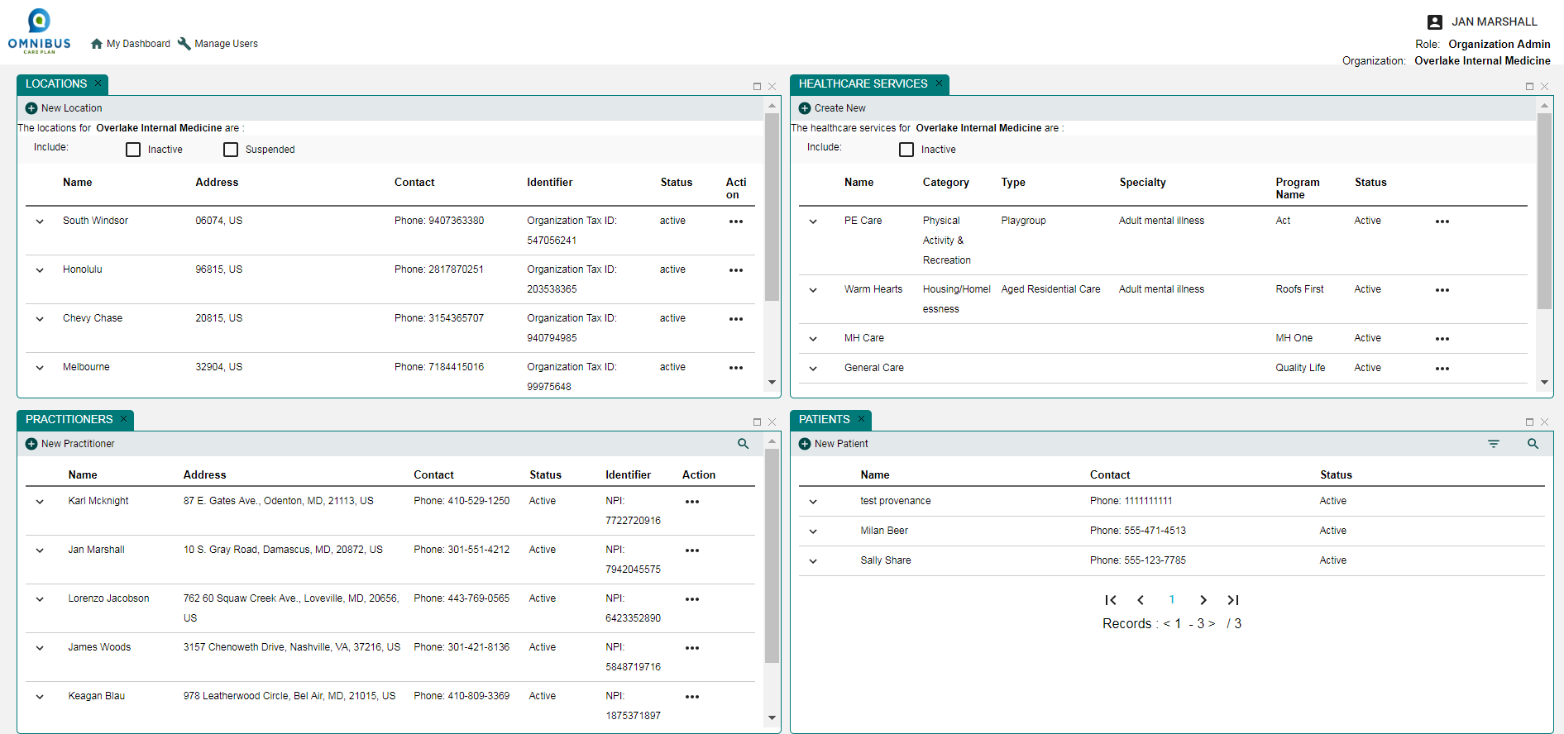
Organization Admin
Top: My Dashboard, Manage Users
Panels: Locations, Healthcare Services, Practitioners, Patients
Notes:
The Dashboard panel order has changed. Please verify and change this screen shot

Slide 12
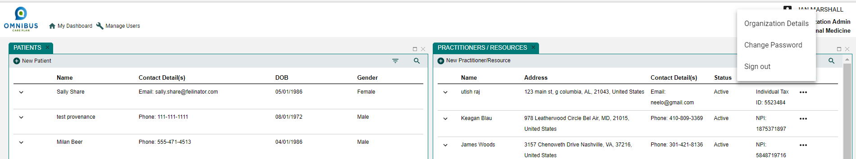
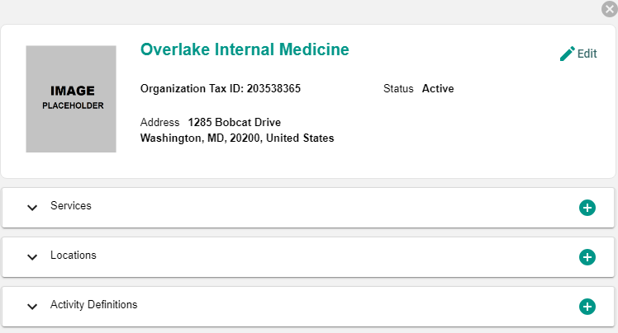
Organization Admin: Organization Profile Slider
Notes:
The Dashboard panel order has changed. Please verify and change this screen shot

Slide 13
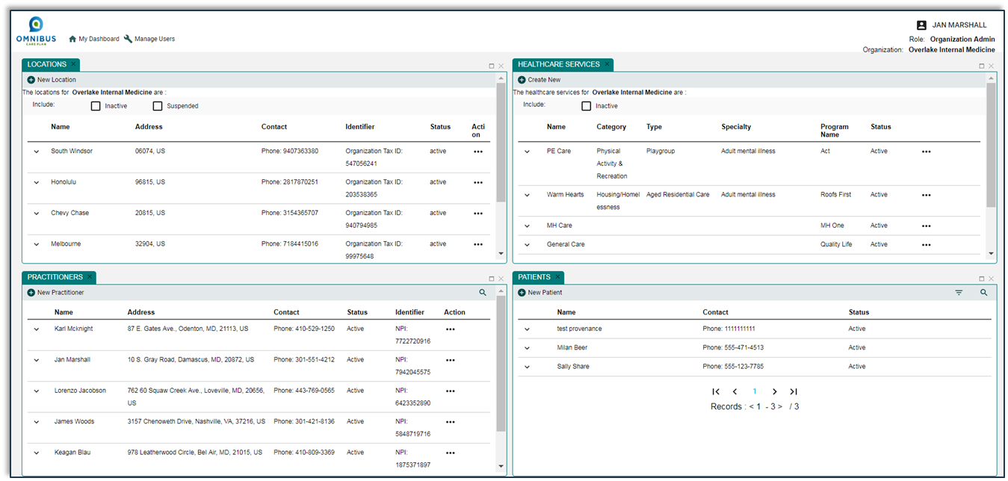
Chapter 1: Manage Locations
This chapter will illustrate how an OCP Organization Admin can:
Create a new location
Assign Existing Healthcare services to a location
Edit Location

Slide 14
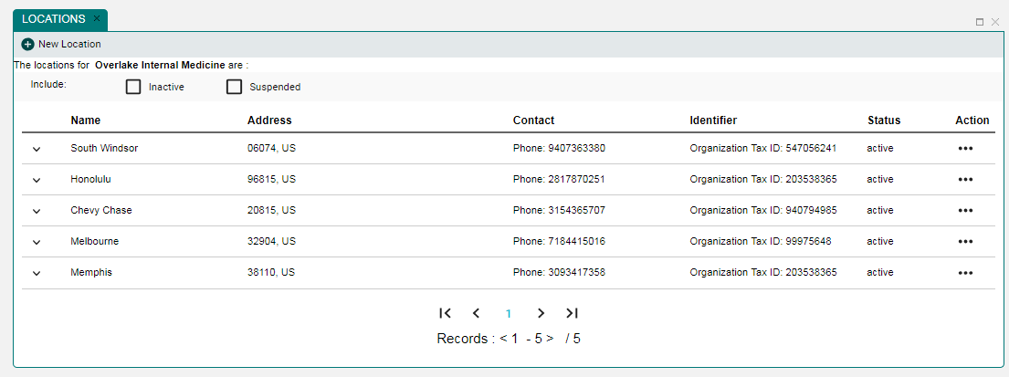
The Manage Locations Panel

Slide 15
New Location Icon
Click New Location icon to create new location

Slide 16
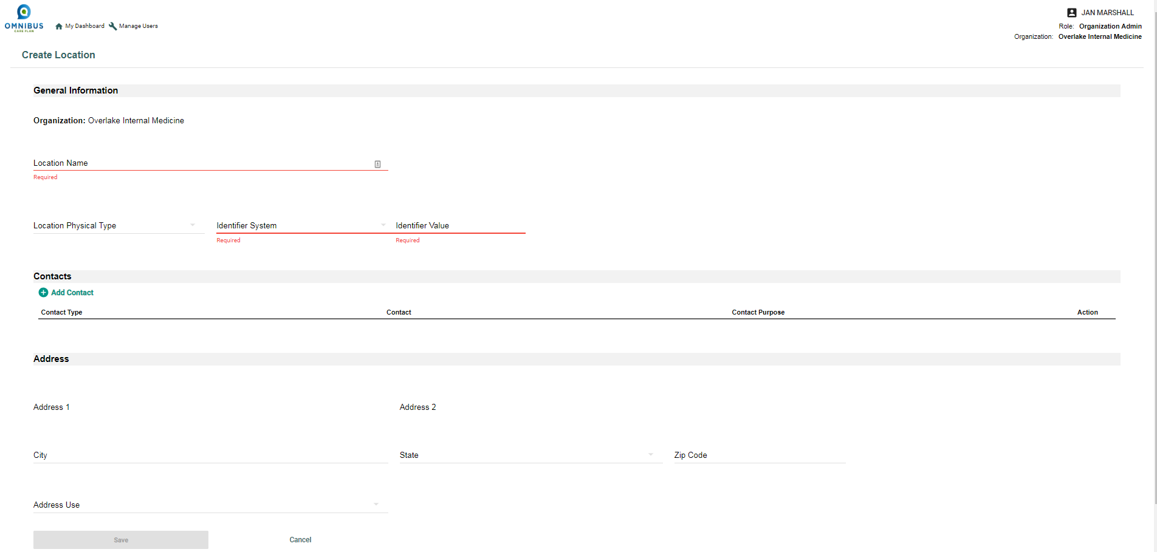
Create Location Page

Slide 17
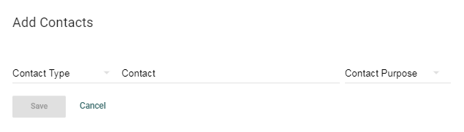
Add Contacts
Select the Add Contact icon and the Add Contacts popup opens.

Slide 18
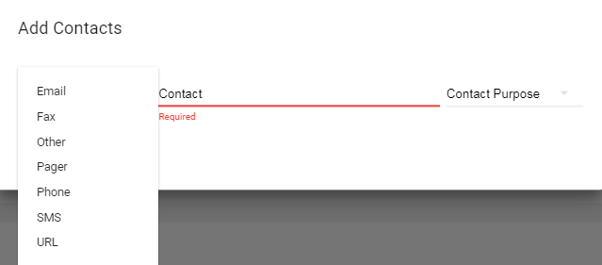
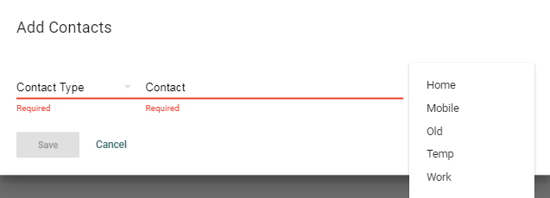
Contact Type and Contact Purpose Options
Contact Type options
Contact Purpose options

Slide 19

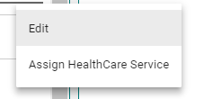
Edit or Assign HealthCare Service
Click Action Ellipses. Edit or Assign HealthCare Service Options open.

Slide 20
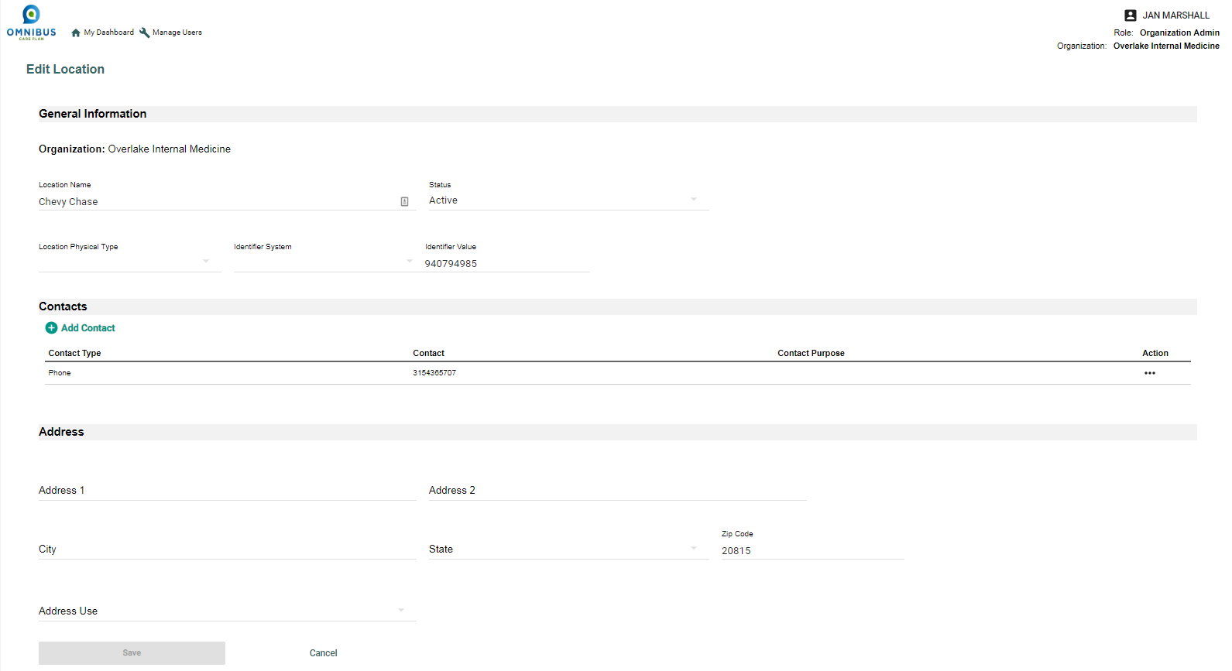
Edit Location Page

Slide 21
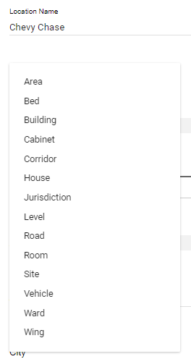
Location Physical Type Options Drop-down

Slide 22
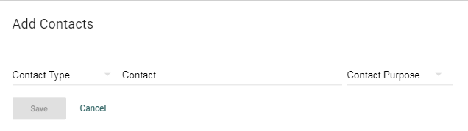
Add Contact
Click Add Contact icon.
Add Contacts popup opens.
Enter information and click save.

Slide 23
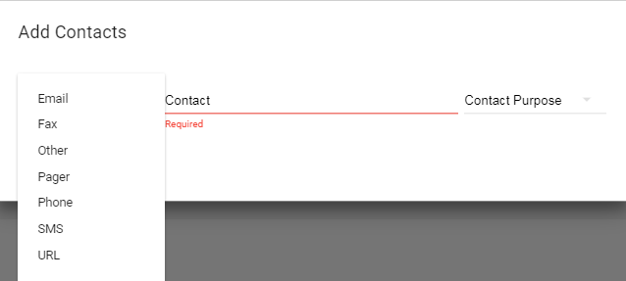
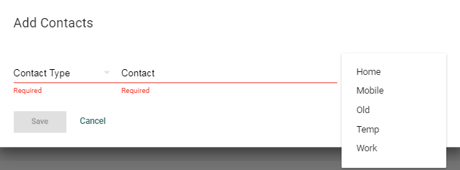
Add Contact
Contact Type options
Contact Purpose options

Slide 24
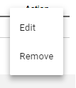
Action Ellipses: Edit or Remove Options

Slide 25
Assign HealthCare Service
Click Action Ellipses.
Edit or Assign HealthCare Service Options open.
Choose Assign.

Slide 26
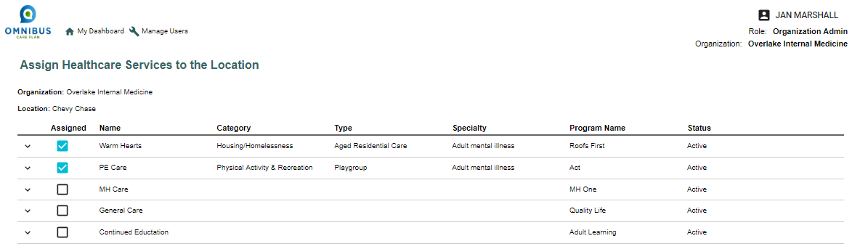
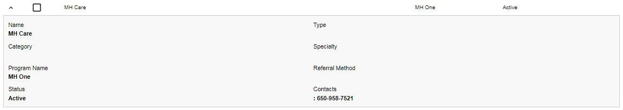
Assign HealthCare Services to the Location
Click boxes to assign services to the location. Click chevron for details.

Slide 27
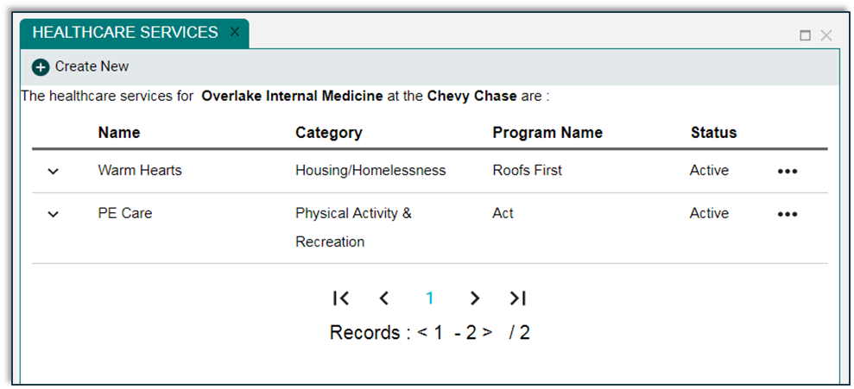
Chapter 2: Manage Healthcare Services
This chapter will illustrate how an OCP Organization Admin can:
Create a new Healthcare Service
Edit a Healthcare Service

Slide 28
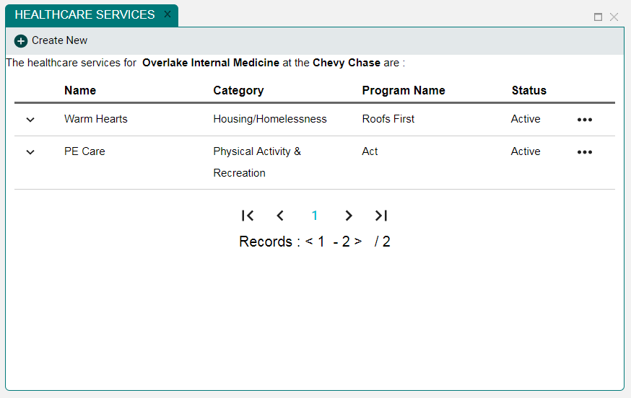
Healthcare Services Panel
First, create a new healthcare service. Click Create New icon.

Slide 29
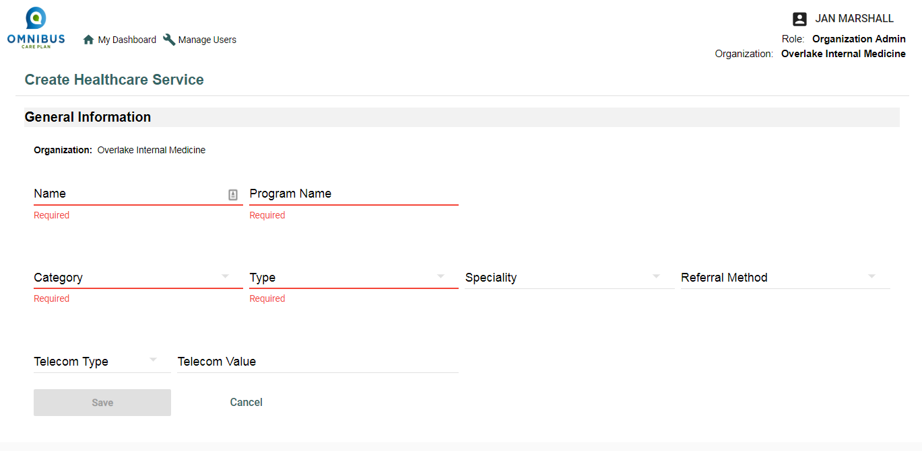
Create Healthcare Services Window

Slide 30
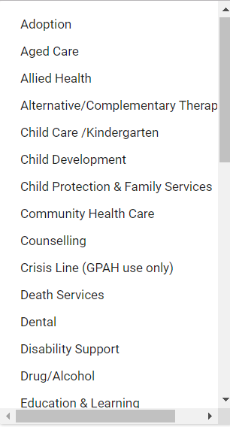
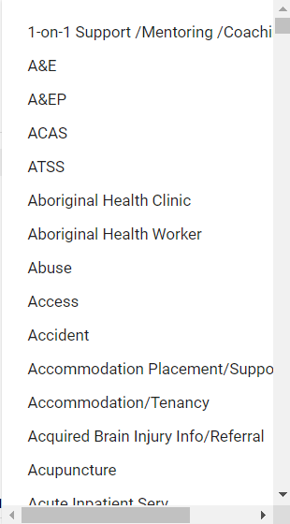
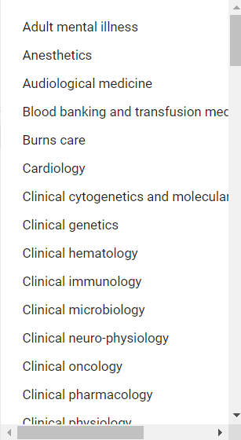
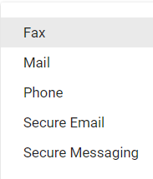
Create Healthcare Service Drop-down Menus
Category Type Specialty Referral
Method

Slide 31

Edit Healthcare Services
Click the ellipses of an existing Healthcare Services
The Edit option will appear

Slide 32
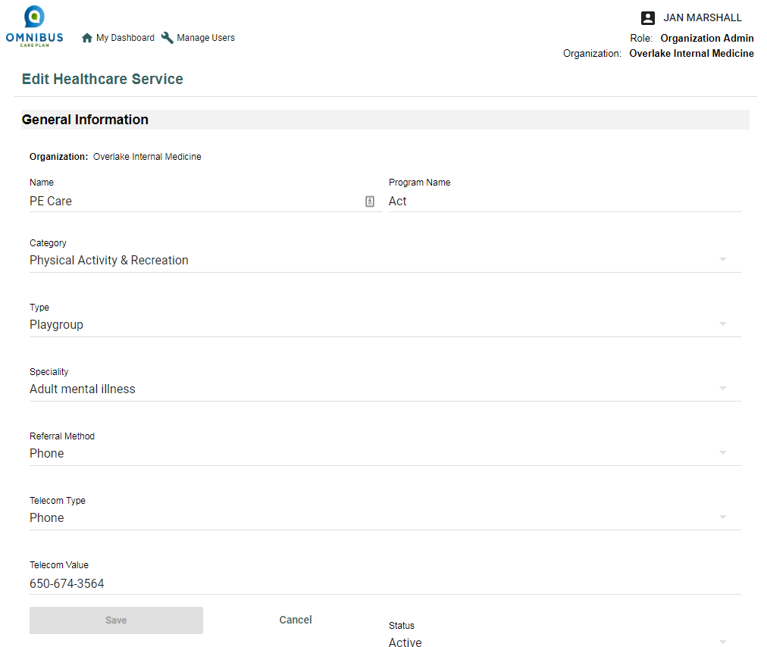
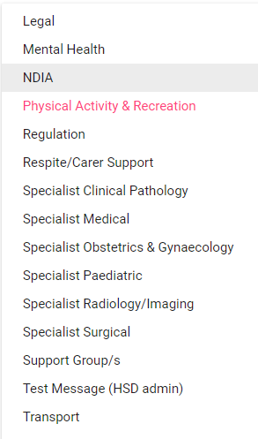
Edit Healthcare Service Page
Edit using drop-down menus.

Slide 33
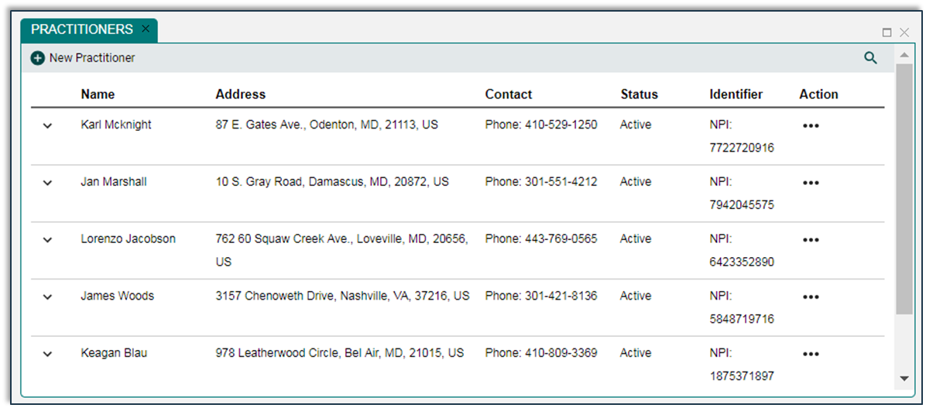
Chapter 3: Manage Practitioners
This chapter will illustrate how an OCP Organization Admin User can:
Add a new Practitioner
Edit Practitioner
Assign Existing Locations to a Practitioner

Slide 34
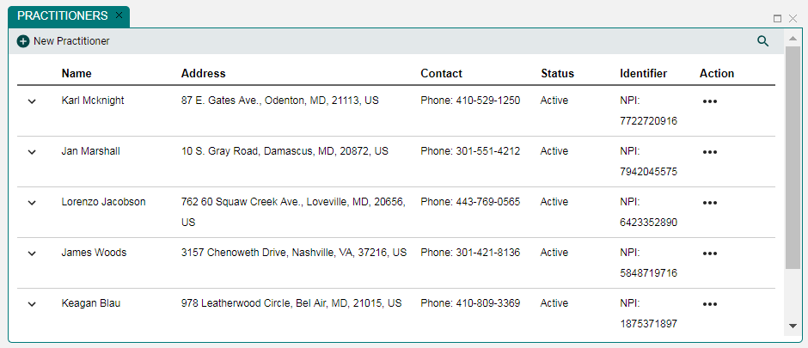
Manage Practitioners Panel
Click New Practitioner icon

Slide 35
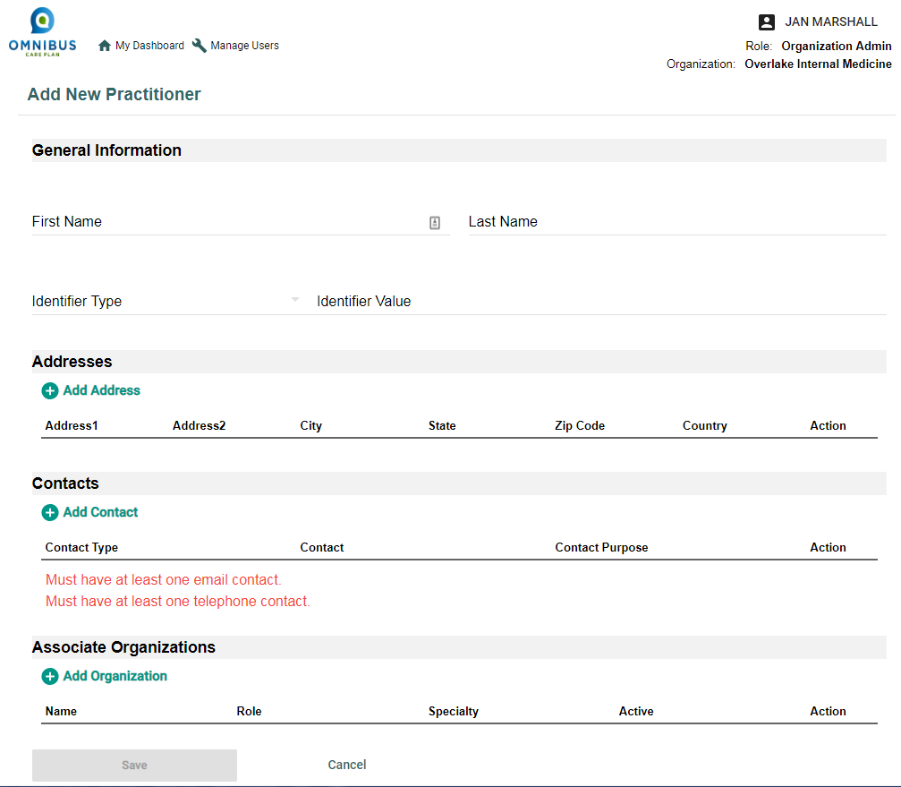
Add New Practitioner Page
Enter required information
Add General Information
Add Addresses
Add Contact
Add Organization
Click the Save button

Slide 36

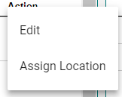
Edit Practitioner or Assign Location
Click Action ellipses. Edit or Assign Location options open.

Slide 37
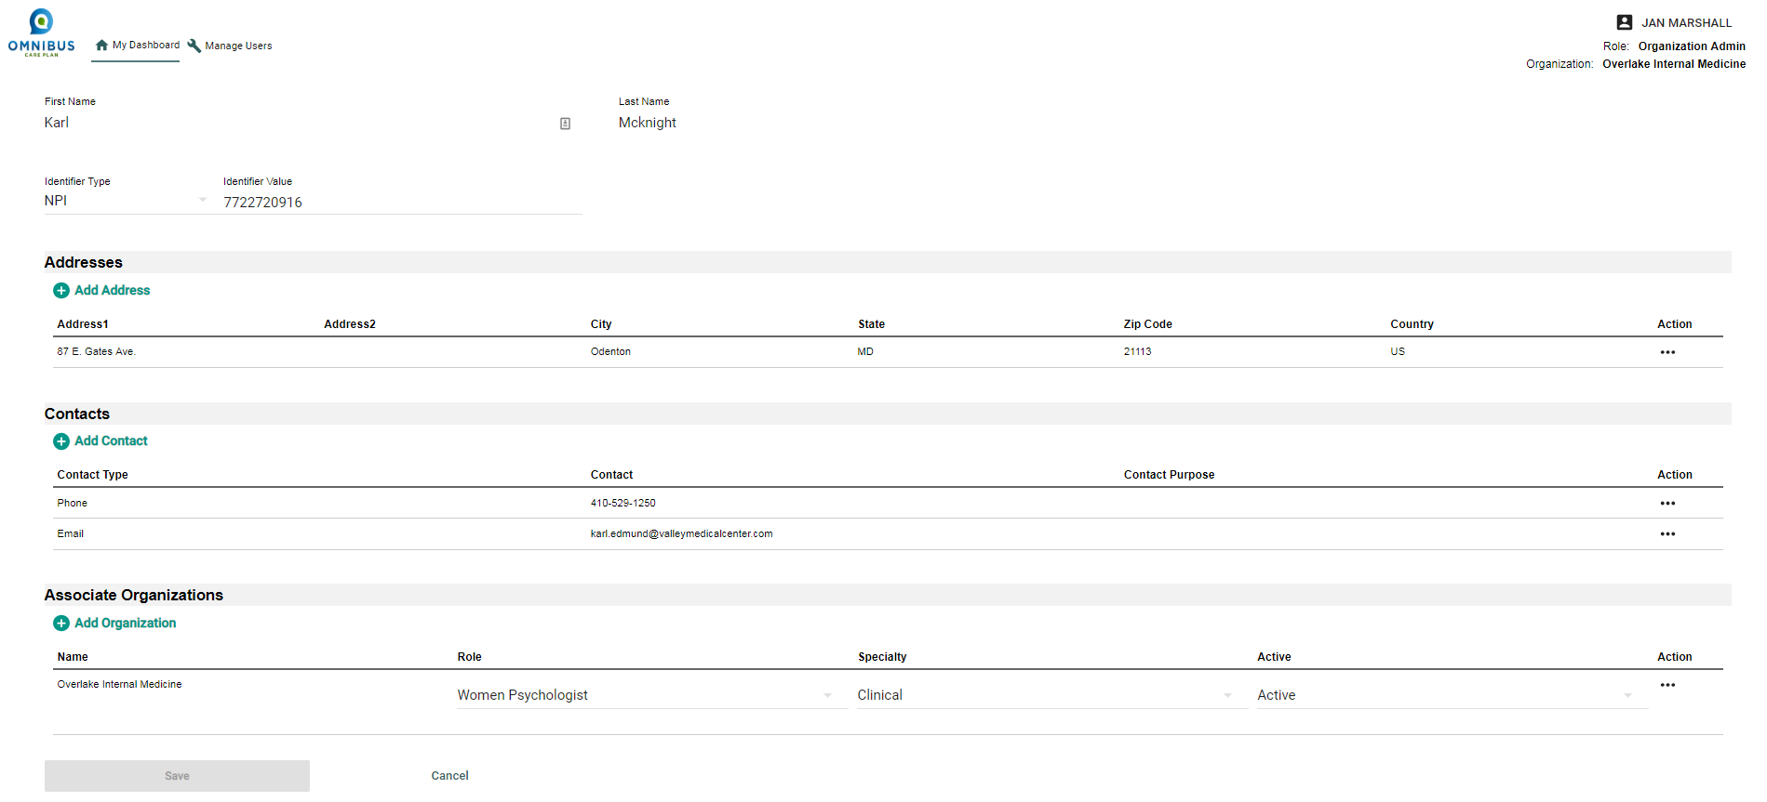
Edit Practitioner Page

Slide 38
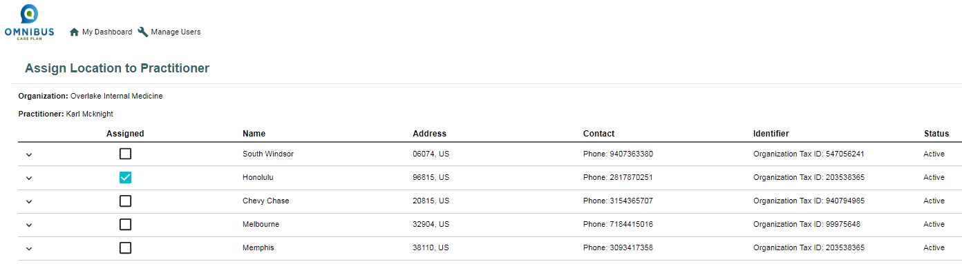
Assign Location to Practitioner Page
Check boxes to assign location to practitioner.

Slide 39
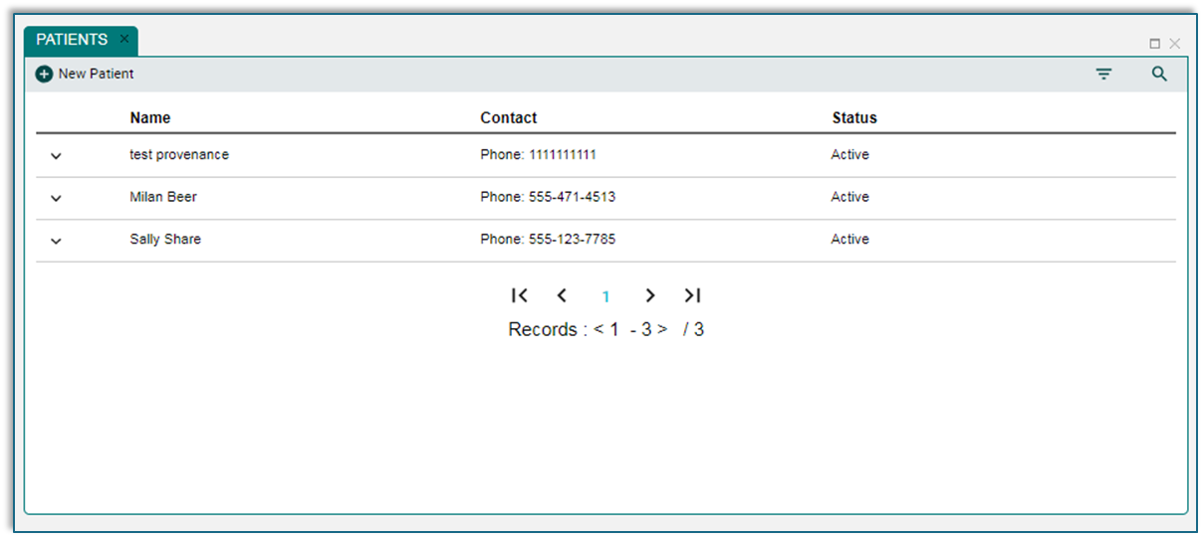
Chapter 4: Manage Patients
This chapter will illustrate how an OCP Organization Admin User can:
Add a new patient
Add patient information
Add contacts
Add address
Add advisory
Add episode of care
View patient profile
Notes:
Some of the bullets is part of main item so the following arrangement is more appropriate (Modify the slides on this chapter so it fits this structure)
Add a new patient
Add patient information
Add contacts
Add address
Add advisory
Add episode of care
Edit Existing patient record
Patient Panel Quick View and available filters
Patient Page Information (Just give a high level overview of Patient Details page and say refer to CM and CC guide for more information)

Slide 40
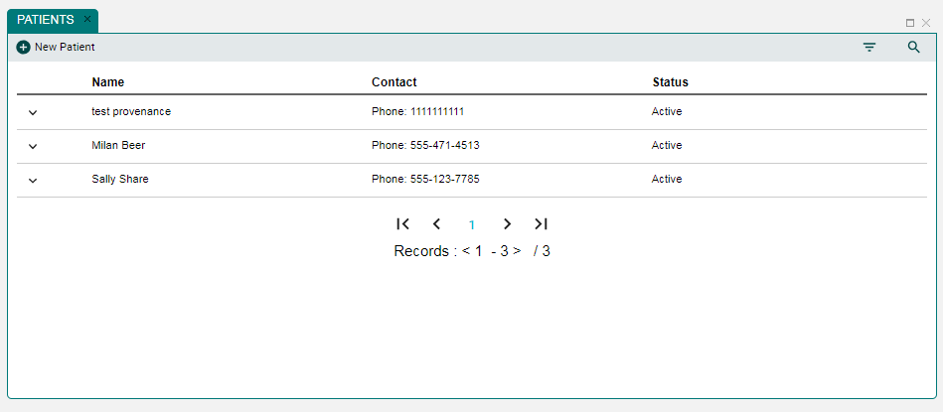
The Manage Patients Panel

Slide 41
Add New Patient
First, click New Patient icon

Slide 42
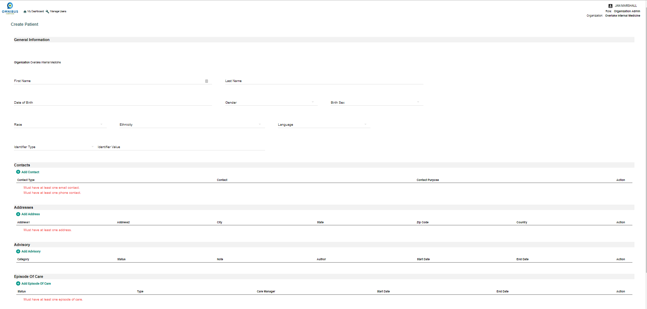
Create Patient Page (Full Page)

Slide 43
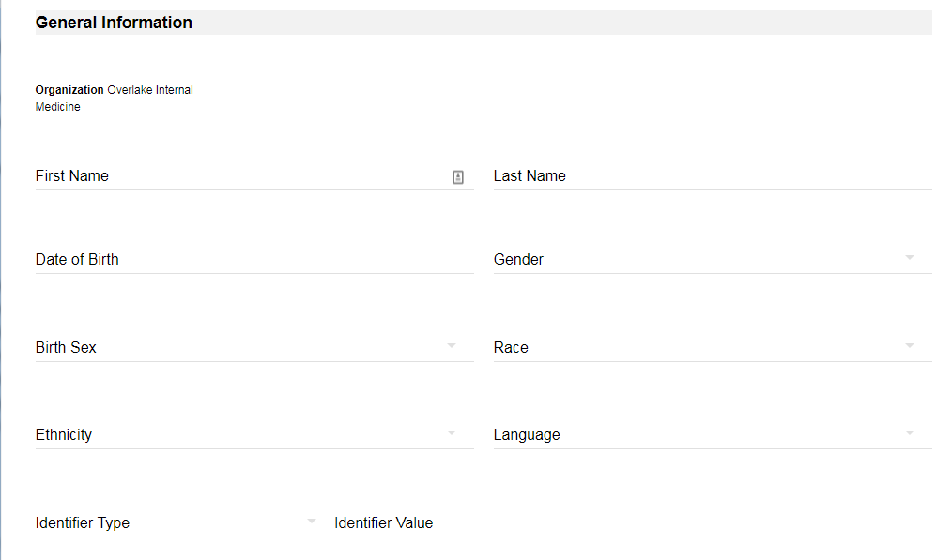
Add General Information

Slide 44
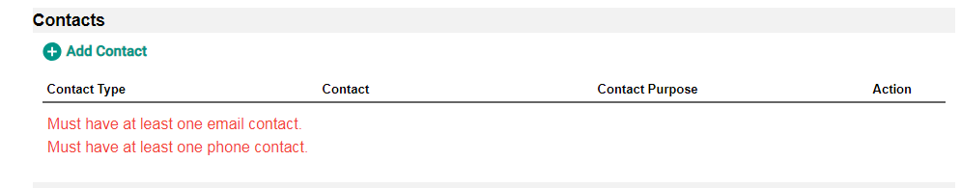
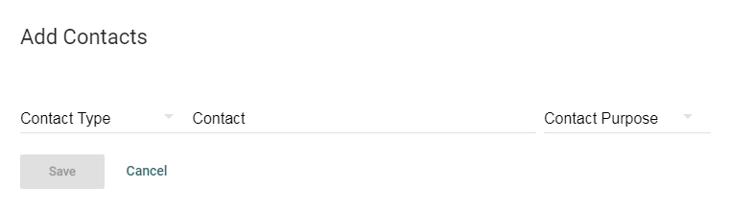
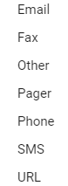

Add Contacts

Slide 45
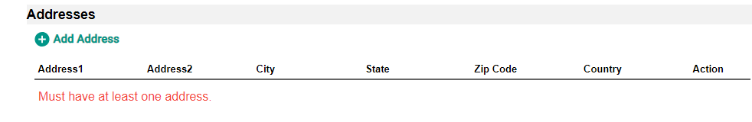
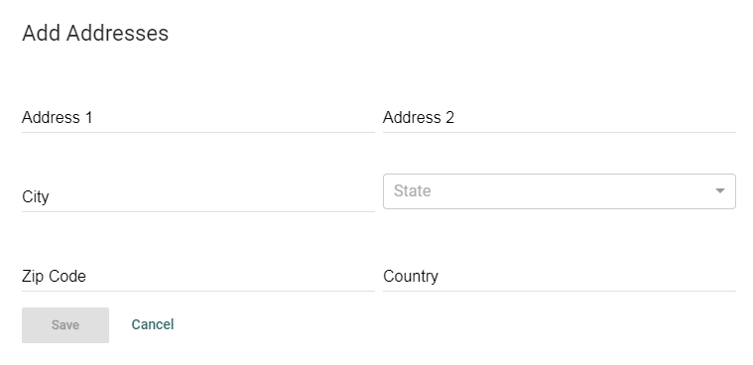
Add Addresses
Select Add Address icon and Add Address popup opens.

Slide 46
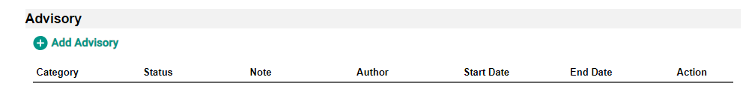
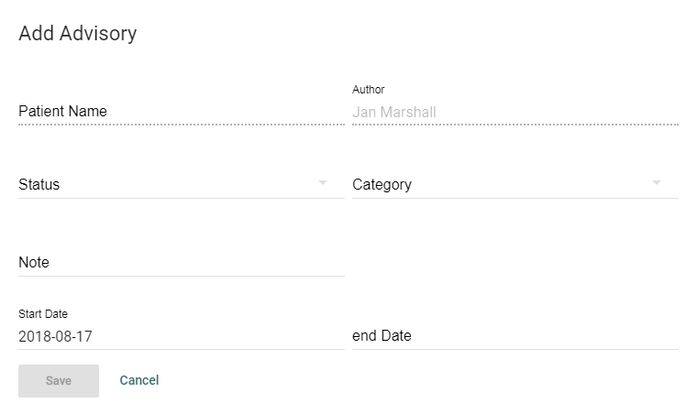
Add Advisory
Select Add Advisory icon and Add Advisory popup opens.

Slide 47
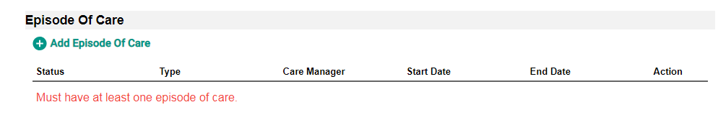
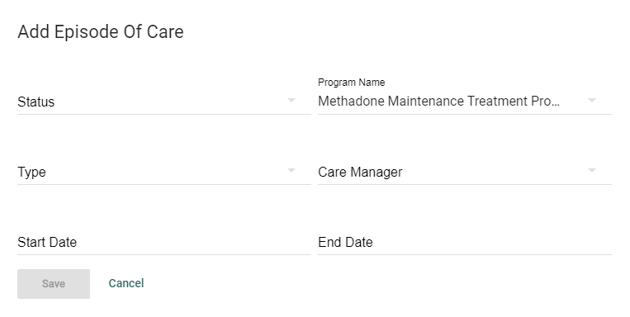
Add Episode of Care
Select Add Episode of Care icon and Add Episode of Care popup opens.

Slide 48
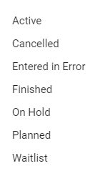
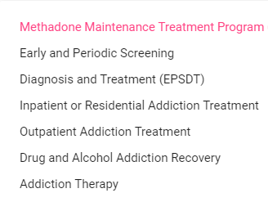

Episode of Care Drop-down Menu Options
Status Type Program Name

Slide 49



Filter and Search
Select Filter icon, filter opens, and drop-down menu provides options.

Slide 50

View Patient Profile: Click Chevron
Click chevron and patient details popup opens.

Slide 51

Chapter 5: Manage Users
This chapter will illustrate how OCP Organization Admin User can:
Assign a Permission group to users
Reset users’ password and/or Remove Users’ access to OCP

Slide 52

Click Manage Users Link

Slide 53


The Manage Users Page

Slide 54


Manage Users: Click Ellipses
Click Action Ellipses and the Assign Role/ Permission group and Reset Password options open.

Slide 55


Manage Users: Assign Role/Permission Group
Select Assign Role/ Permissions Group and Assign Role popup opens.

Slide 56


Manage Users: Reset Password
Select Reset Password and the Reset Password popup opens.

Slide 57


Manage Users: Reset Password
Select Remove user access deletes the user from OCP.

Slide 58

Thanks!

